Slide 1


Human Perception and Evaluation of a Robot’s Pointing Capability
Or, How I Learned to Stop Worrying About the Robot and Love the Laser
Bryan MacGavin and Jen Tennison

Slide 2
Motivating Question
When a robot points →
…how does precision →
…affect human interpretation →
…of where an object would be?

Slide 3
Social Building Blocks
Deixis – Pointing Cues
Kinesics – Spatial Movement

Slide 4
Previous Work
An interactive robotic arm for assisting elderly throughout a home-like settings^{[1]}
How speech, speech + gesture + congruency, and speech + gesture + incongruency can affect human understanding^{[2]}
The effect of robotic presence on how requests and personal space are perceived^{[3]}
Robotic visual recognition of human pointing gestures for human-robot interactions^{[4]}

Slide 5
Research Question
How precisely can humans determine where a robot is pointing?
2 Studies
Identifying a region being pointed at
Identifying a point being pointed at

Slide 6



Study Procedure
Study 1: Region Identification
Participant stands directly behind arm.
Robot naturally points to 1 of 9 regions on a whiteboard.
Participants decide what region the robot is pointing.
Participants are asked how confident they are in their response.
A laser attached to the arm reveals to the participant precisely what position the robot was pointing.
Participant's correctness is recorded.
Study 2: Point Identification
Participant stands directly behind arm.
Robot naturally points to 1 of 3 targets on a whiteboard.
A participant then makes a decision about where the robot is pointing and marks on whiteboard.
A laser attached to the arm reveals to the participant precisely what position the robot was pointing.
Deviation from participant’s point to robot’s point is calculated.

Slide 7
Measurements
Participant’s Correctness
Interpreting where the robot is pointing
Participant Confidence
Rating their selection choice
Deviation
Robot’s actual pointing location and participant’s interpretation of the location

Slide 8
Implementation

Slide 9
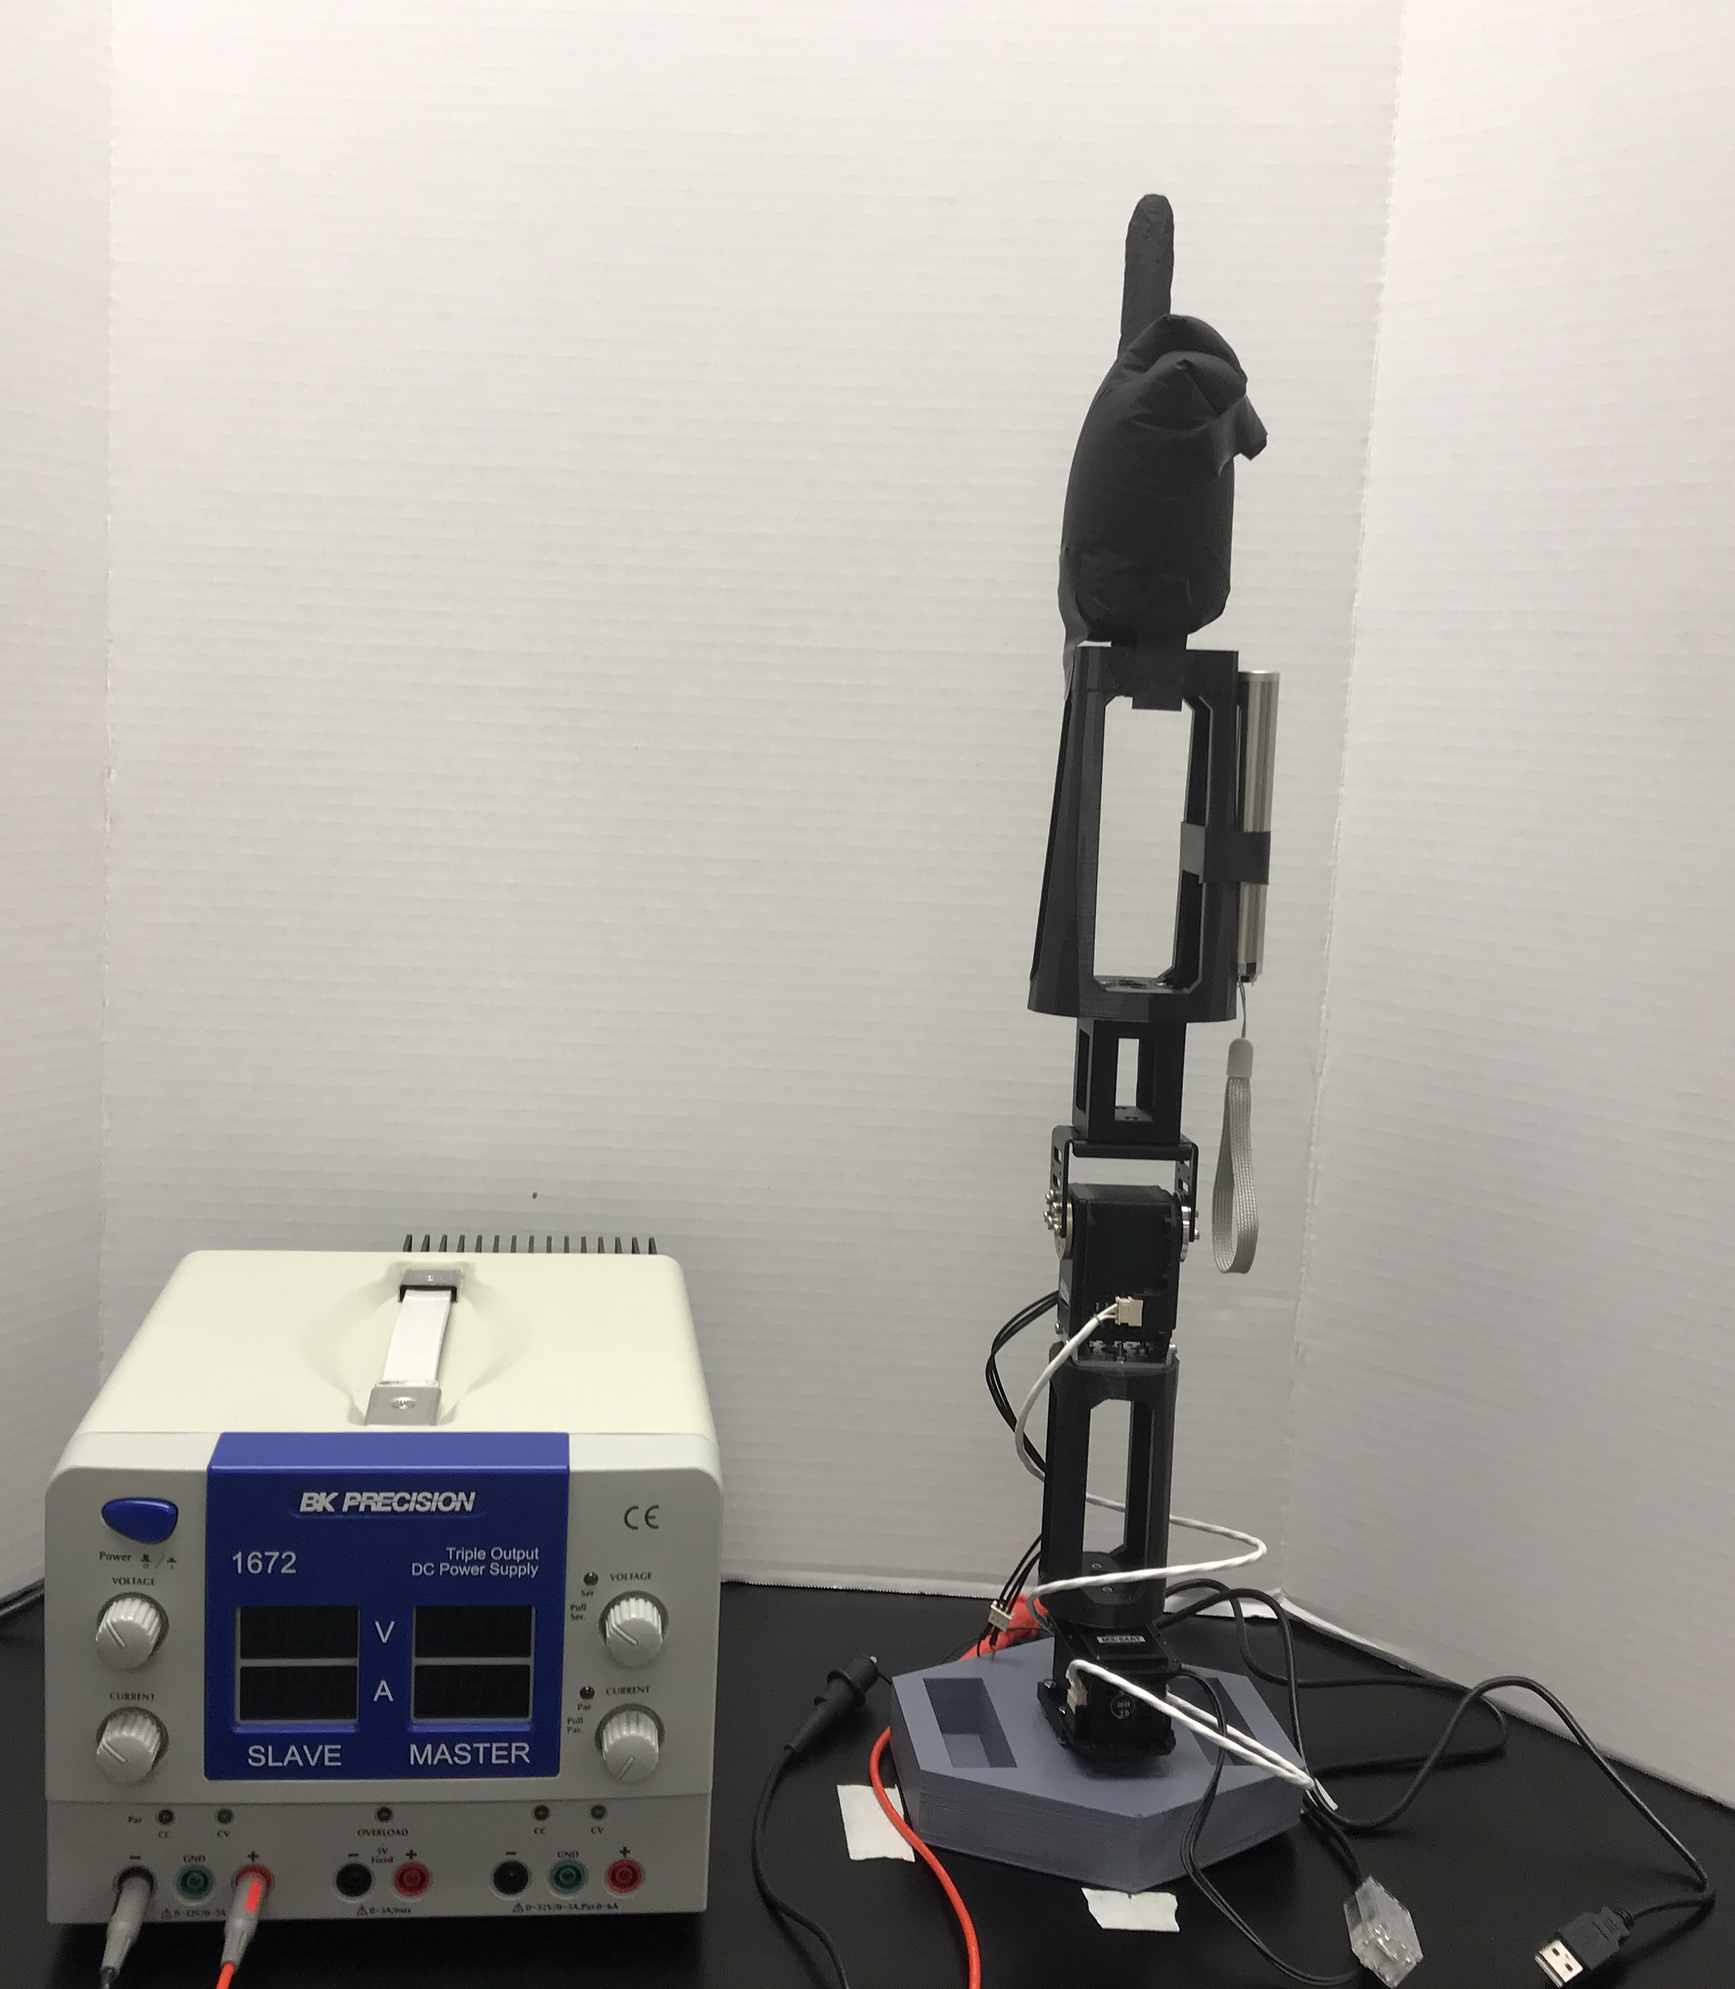
Pointing Hand
Power Supply (12 V)
Laser
Robotic Arm (2 DOF)

Slide 10
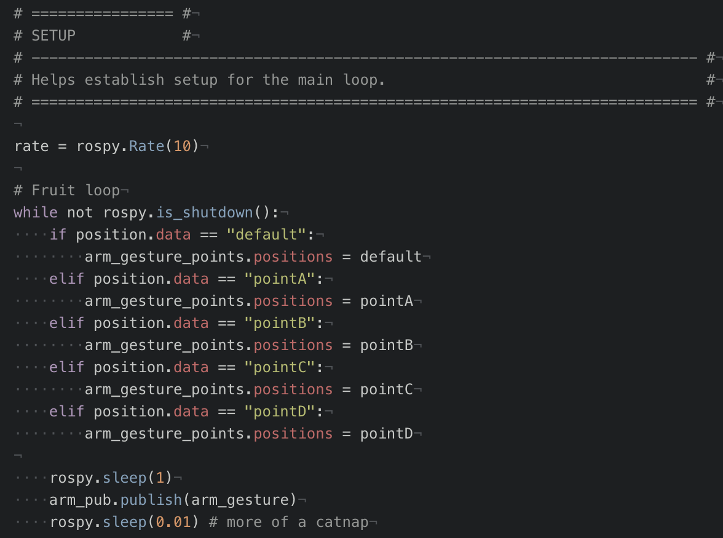
Functionality of Main Loop:
Points A-D are predetermined in the file.
A command is published to /arm_gestures channel and is saved to position.data.
The position message is evaluated in the main loop.
arm_gesture points are set according to the message received.

Slide 11
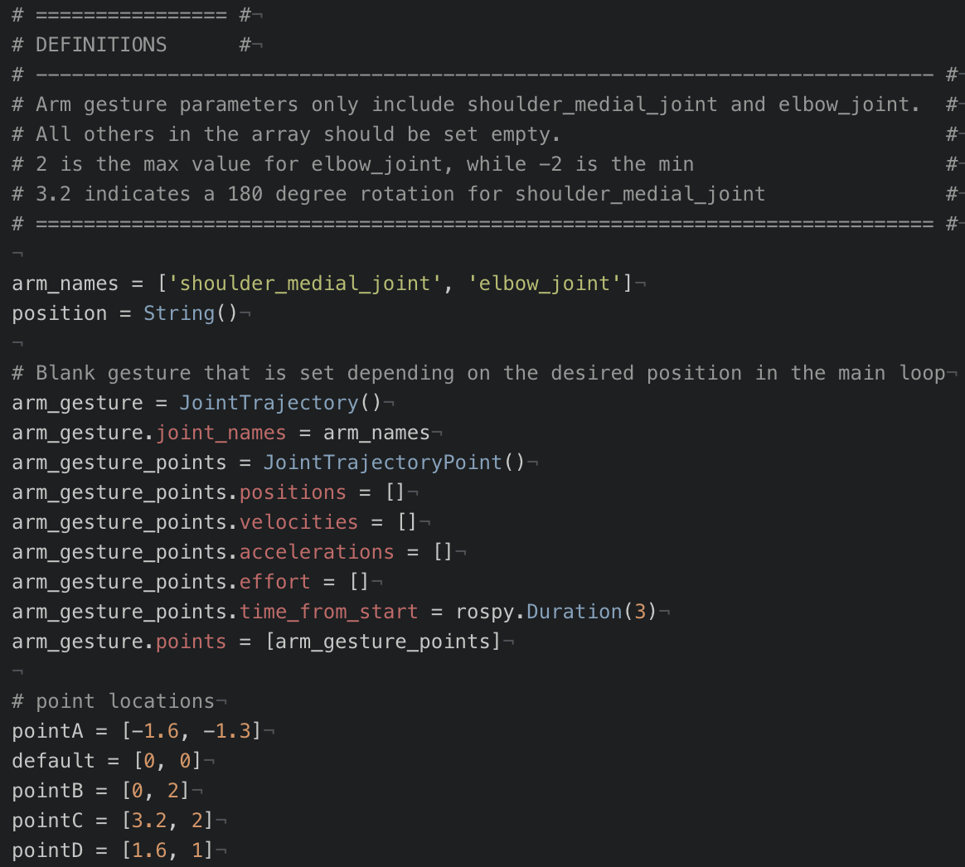
Variable Definitions:
One JointTrajectory variable (arm_gesture) is used to move all points.
Arm_gesture_points.positions is overwritten by each point location and depends on the message received from /arm_gestures channel.

Slide 12
Challenges with Implementation
ROS issues
Cutecom is just how the name sounds
TGFAS (Thank God For Arm Sliders)
But also, not
Why so many errors?
Did you chmod 777?

Slide 13
Hardware Challenges
Arm:
Initial arm set up with correct wiring and usb plug in
Interfacing between ROS and motors

Slide 14
Software Challenges
Reflashing with new libraries
Arm:
Accounting for error accumulation in trajectory movement
List of setup commands need to run after restart
Catkin build
Close terminal
Setup.bash
Activate correct usb port
Then roslaunch
Sliders with rqt_joint_trajectory_controller

Slide 15
What We Learned
Git
Integration into ROS usb
VIM and how to commit
ROS
How to send messages to the arm motors
Simulation vs. actual arm testing
Structure of messages
Hardware setup
The Beauty of Improvisation

Slide 16
References
https://ieeexplore.ieee.org/stamp/stamp.jsp?tp=&arnumber=6840112
https://link.springer.com/content/pdf/10.1007%2Fs12369-013-0196-9.pdf
https://ieeexplore.ieee.org/stamp/stamp.jsp?tp=&arnumber=4600749
https://www.sciencedirect.com/science/article/pii/S0262885606002897

